Slide 1
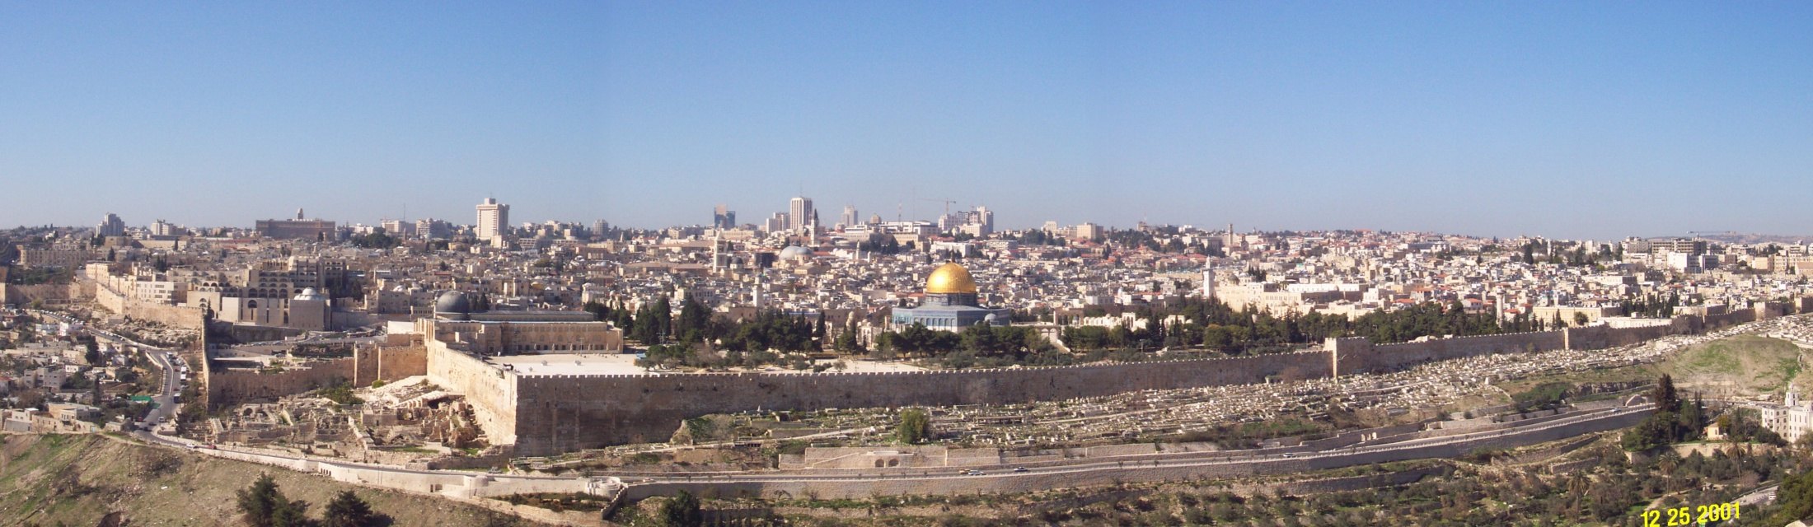

Who/How to Blame for Attacks on the Internet Infrastructure?
Michael Schapira
School of Computer Science and Engineering

Slide 2
3 stories, 1 theme
The Internet infrastructure is alarmingly insecure
The Internet’s infrastructure was designed in the 80’s without security in mind
Security not even on the horizon

Slide 3

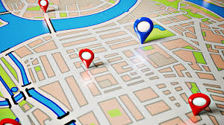

3 stories, 1 theme
Naming/addressing with the Domain Name System (DNS)
  DNS = the Internet’s phone book
  google.com = ?
Routing with the Border Gateway Protocol (BGP)
  BGP = the Internet’s google maps / Waze
The Network Time Protocol (NTP)
  NTP = the Internet’s global clock

Slide 4
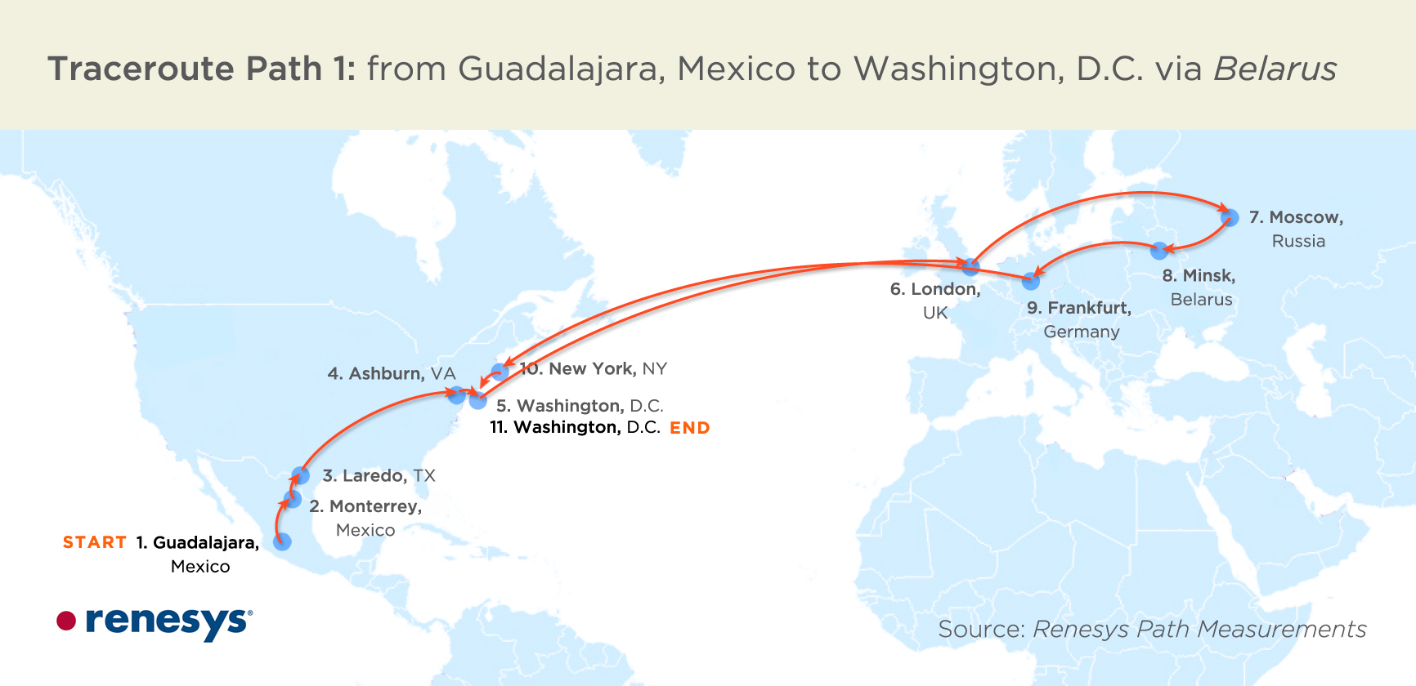
An Anecdote
Repeated attacks against major financial institutions and governments in Europe and the US

Slide 5
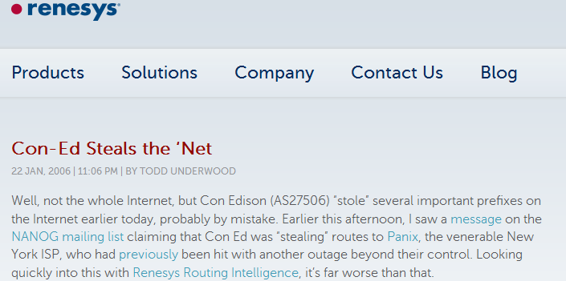
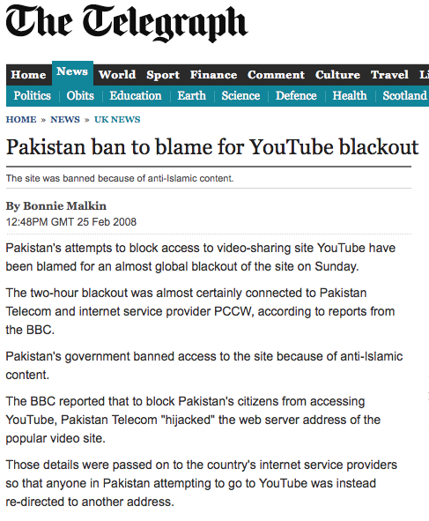
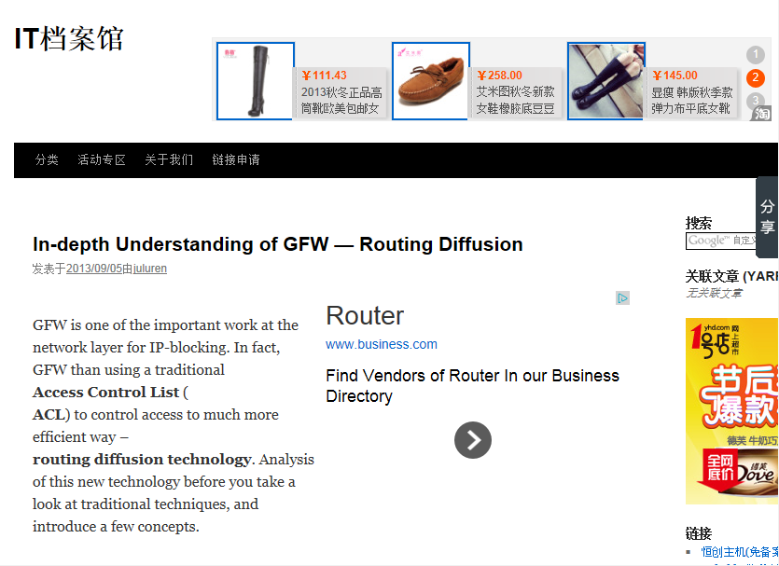
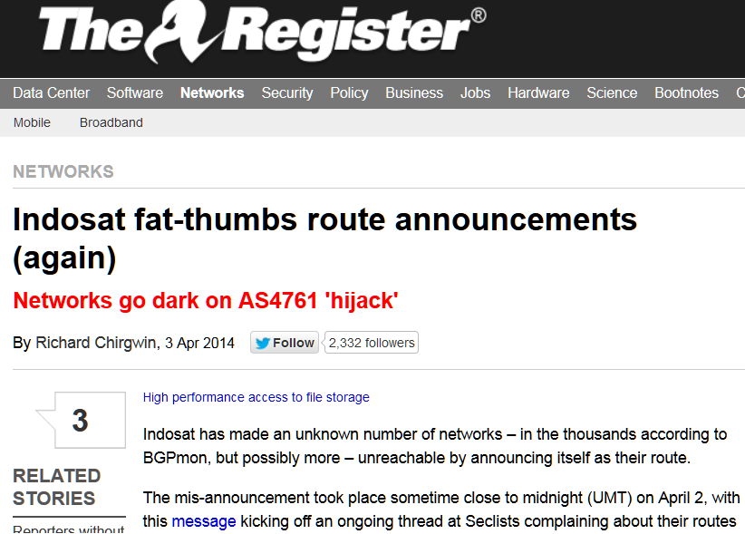
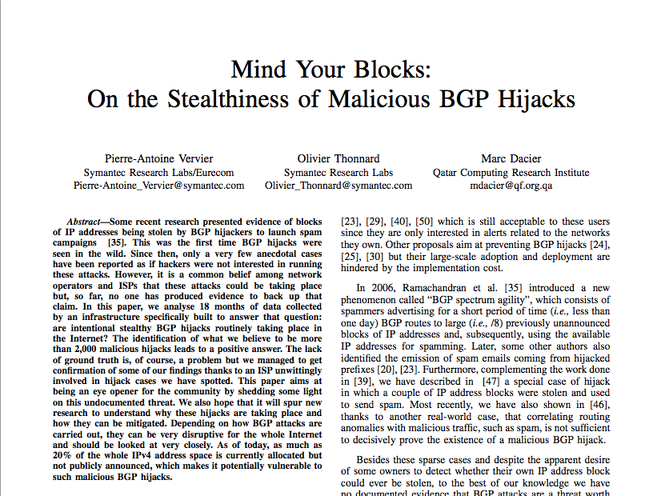
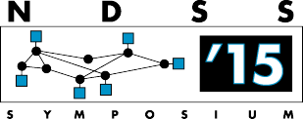
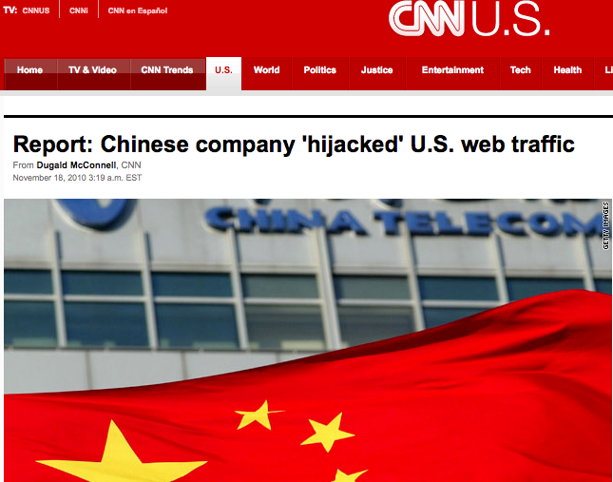
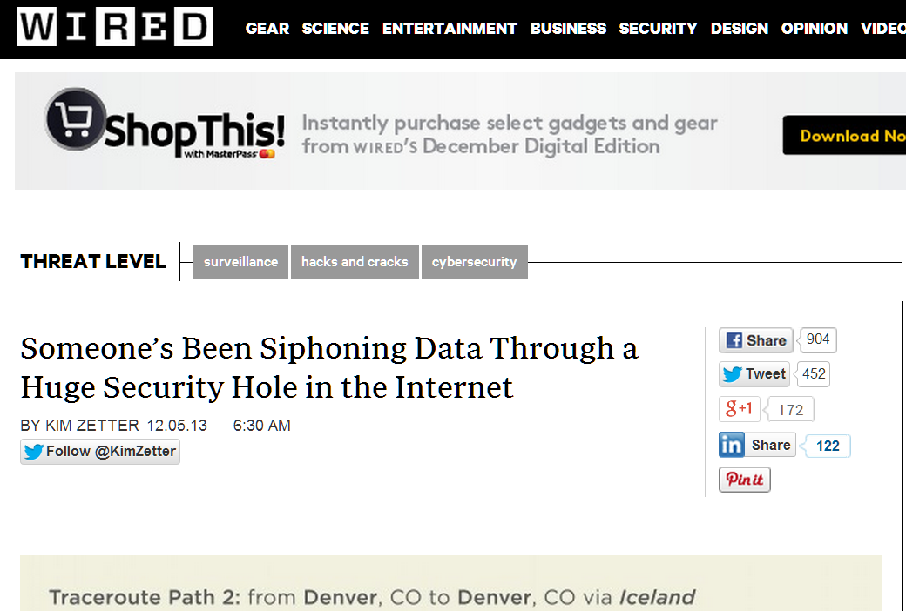
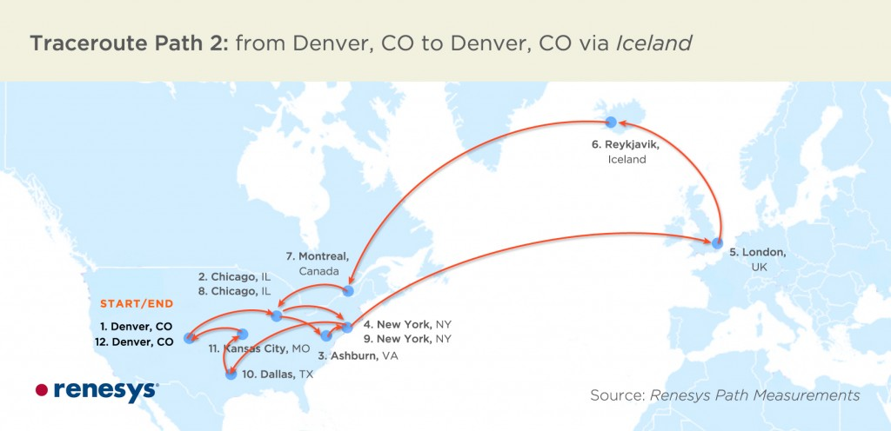
Rare Incident? Not Really!
Notes:
Add turkish telecom!

Slide 6
Why Do this?
To disconnect victim from the Internet (large corporation, nation state, …)
To be a man-in-the-middle
(snoop on traffic, tamper with traffic, …)
To impersonate the victim
To hide under someone else’s identity
To attack protocols/mechanisms that utilize Internet routing (BitCoin, DNS, …)
…

Slide 7
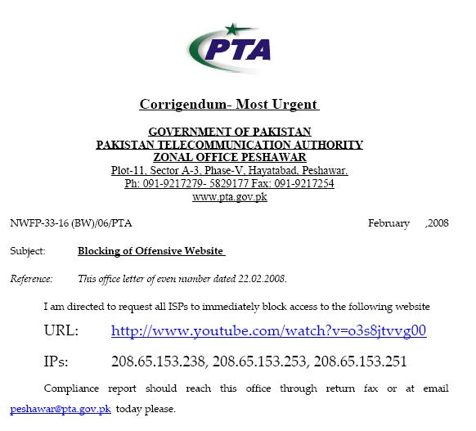
Another Anecdote
  February 2008: Pakistan Telecom hijacks YouTube!
The Internet
Pakistan
Telecom
YouTube
I’m YouTube:
IP addresses: ****
Notes:
-level of autonomous systems
-e.g., YouTube, AT&T, pakistan telecom
-routing is done on IP addresses, so when someone wants to go to YouTube they get YouTube’s IP address and YouTube announces to the world that they have the ip address and traffic is forwarded towards them. So here multinet would route to it’s provider pakistan telecom that then forwards the traffic on to youtube.
-these networks chosen for a specific reason which is that there was an incident in february 2008 pakistan telecom actually high jacked traffic going to youtube (misconfiguration).
-they announced to the world that they’re youtube and traffic destined to youtube was routed to them
-youtube was unavailable for a couple of hours as operators phone each other to figure out what was going on.

Slide 8
Another Anecdote
drop packets
Pakistan
Telecom
X
YouTube
I’m YouTube:
IP addresses: ****
  What should have happened…
Notes:
-level of autonomous systems
-e.g., YouTube, AT&T, pakistan telecom
-routing is done on IP addresses, so when someone wants to go to YouTube they get YouTube’s IP address and YouTube announces to the world that they have the ip address and traffic is forwarded towards them. So here multinet would route to it’s provider pakistan telecom that then forwards the traffic on to youtube.
-these networks chosen for a specific reason which is that there was an incident in february 2008 pakistan telecom actually high jacked traffic going to youtube (misconfiguration).
-they announced to the world that they’re youtube and traffic destined to youtube was routed to them
-youtube was unavailable for a couple of hours as operators phone each other to figure out what was going on.

Slide 9
Another Anecdote
No, I’m YouTube!
IP addresses: ****
Pakistan
Telecom
Pakistan
Telecom
YouTube
I’m YouTube:
IP addresses: ****
  What did happen…
Notes:
-level of autonomous systems
-e.g., YouTube, AT&T, pakistan telecom
-routing is done on IP addresses, so when someone wants to go to YouTube they get YouTube’s IP address and YouTube announces to the world that they have the ip address and traffic is forwarded towards them. So here multinet would route to it’s provider pakistan telecom that then forwards the traffic on to youtube.
-these networks chosen for a specific reason which is that there was an incident in february 2008 pakistan telecom actually high jacked traffic going to youtube (misconfiguration).
-they announced to the world that they’re youtube and traffic destined to youtube was routed to them
-youtube was unavailable for a couple of hours as operators phone each other to figure out what was going on.

Slide 10

Attack: Hijacking IP Addresses
The Internet
My IP addresses are ***
Organization
1
Organization
2
No, my IP addresses are ***!
Notes:
One of many attacks

Slide 11
Attack: Manipulating the Path
The Internet
My IP addresses are ***
Organization
1
Organization
2
AS 1 is my neighbor
Notes:
One of many attacks

Slide 12
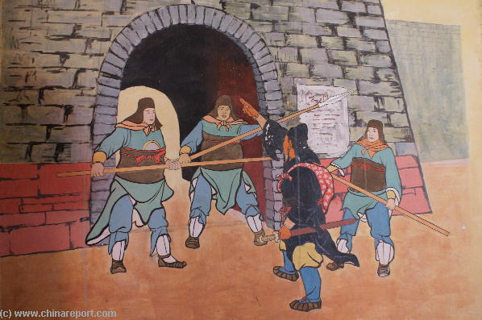
What’s So Special About These Attacks?

Slide 13
What’s So Special About These Attacks?
Devastating
  Can bring down an organization/state
Easy to launch
  All you need is a BGP router
Hard to detect in real time
  often only detected (if at all) after the fact
Plausible deniability
  configuration errors are common!
  market for compromised routers
Departure from Traditional Warfare

Slide 14
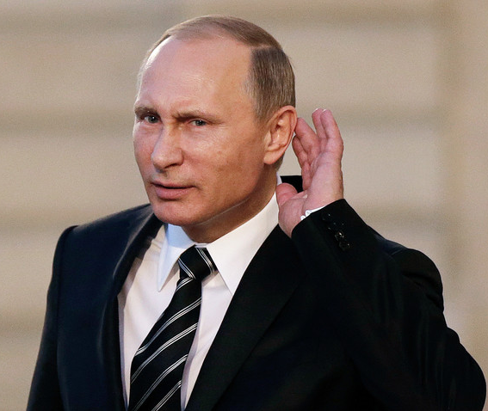
Did Russia Manipulate the
US Presidential Elections?
President Vladimir V. Putin of Russia suggested on Thursday that “patriotically minded” private Russian hackers could have been involved in cyberattacks … Hackers, he said, “are like artists” who choose their targets depending how they feel “when they wake up in the morning.”
(NY Times, June 2017)

Slide 15
Routing Security is a Distant Dream
Step 1: Create a secure database (<6%)
  Organizations -> Internet addresses
Step 2: Replace today’s routing protocol (BGP) (0%)
  BGPsec

Slide 16


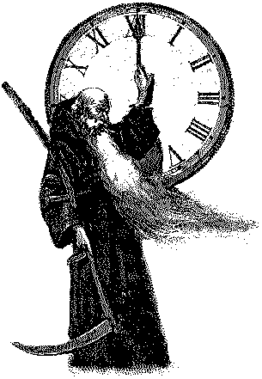
Securing from Cyber Attacks
Hermes
Securing Internet Routing
Dionysus
Securing Naming/Addressing
Chronos
Securing Network Time

Slide 17

The Path to Adoption
How to agree on a solution?
Is regulation an option?
Otherwise, solution must be
  beneficial to early adopters
  backwards compatible with legacy technologies
  safe to deploy alongside existing technologies
  …

Slide 18
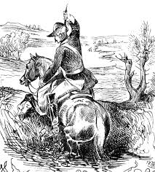
Can We Bootstrap
Internet Security?

Slide 19
Thank you

